Slide 2
Hospital Management
ADVANCED

Slide 3
Activity scenario summary:
In this example we will code a project, which replicates a simple Hospital Management System, used by Doctors and Nurses. This project will help you develop an understanding how coding is used in Hospitals. As part of the activity participants will design a software in which the nurse/hospital staff will be able to;
admit a patient,
see the occupied and vacant bed lists,
add expenses, show all expenses,
Generate a bill for the patient,
Discharge the patient.
For this section of the program, the user will be able to generate a bill for the patient and discharge them

Slide 4
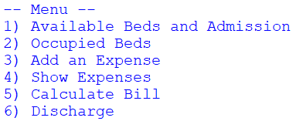
Add an Expense
Calculate Bill:
Add up expenses
Add bed charge
Display total to the user
Find the finished code for this project here – use this if you get stuck!

Slide 5
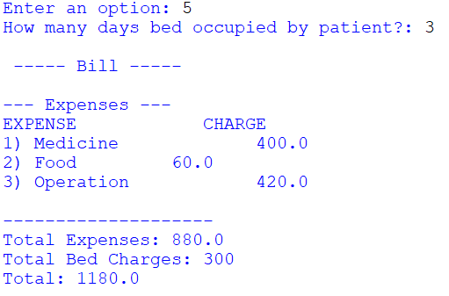
What will happen…

Slide 6
Step 1
First we declare a subroutine - subroutines are small blocks of code that perform specific tasks
Defining a subroutine….
Ask the user to enter the number of days the patient has occupied a bed
We then call our viewExpenses() subroutine – this will show all of our expenses and their prices

Slide 7
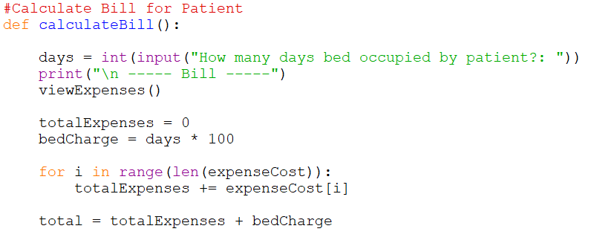
Step 2
Create a totalExpenses variable – this will store the total cost of our expenses.
Calculating cost…
Also, create a bedCharge variable – set this equal to £100 for every day the patient stayed
Use a FOR loop to go through every item in the expenseCost list and add each expense to our total.
Then create a total variable and set it equal to bedCharge + totalExpenses

Slide 8
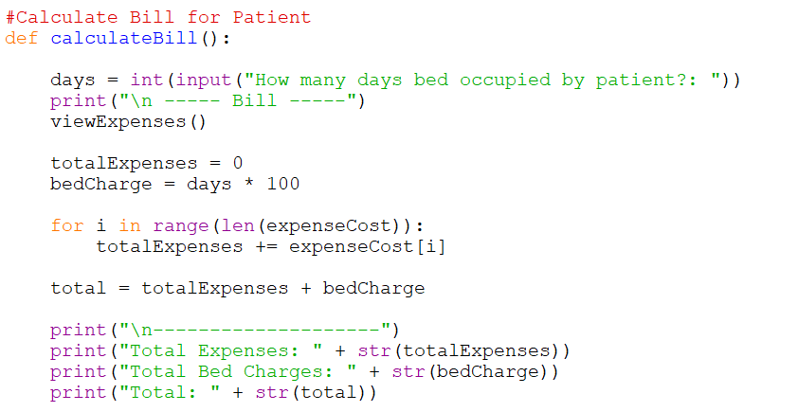
Step 3
Displaying total…
Finally, display the final variables using print statements at the bottom of the subroutine.

Slide 9
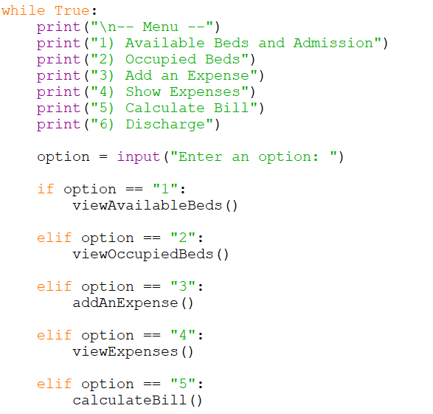
Step 4
Updating the menu…
Update the menu by calling the ‘calculateBill()’ subroutine when option is equal to 5.

Slide 10
What the code will look like…

Slide 11
Discharge Patient
Discharge Patients:
User enters bed to discharge
Bed moved from occupied list into available list
Find the finished code for this project here – use this if you get stuck!

Slide 12
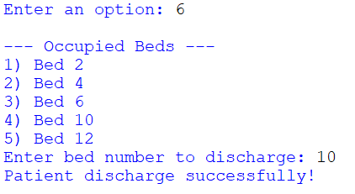
What will happen…

Slide 13
Step 1
First we declare a subroutine - subroutines are small blocks of code that perform specific tasks
Defining a subroutine….
Call the viewOccupiedBeds() subroutine to show the user which beds are available
Then, use an input statement and store the bed number in a variable

Slide 14
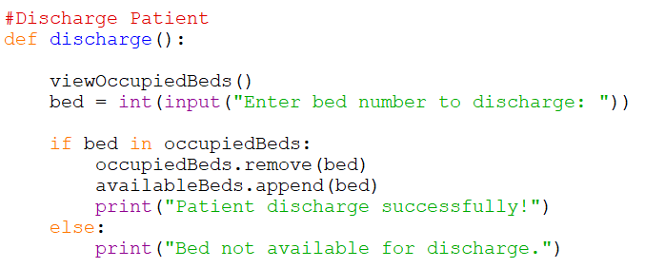
Step 2
Add an IF ELSE statement. IF the bed number the user has entered exists within the list, remove it from the occupiedBeds list and add it into the availableBeds list
Updating lists…
ELSE, print out a message asking the user to try again later.

Slide 15
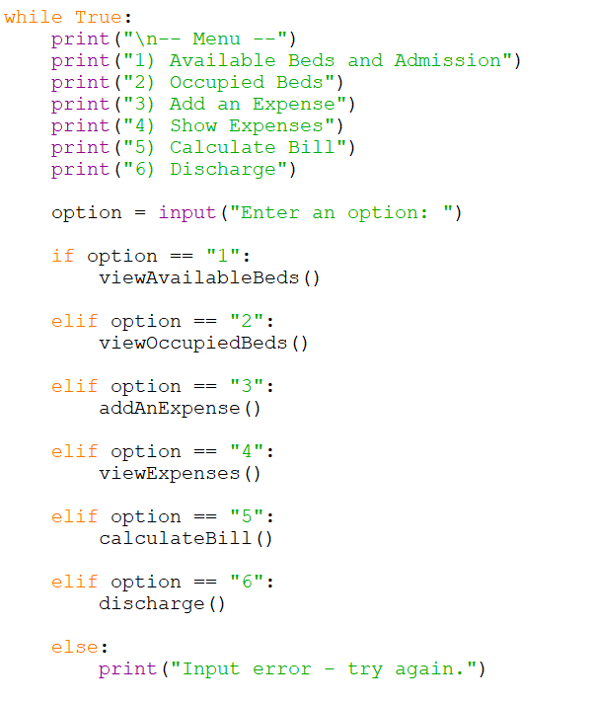
Step 3
Updating the menu…
Update the menu by calling the ‘discharge()’ subroutine when option is equal to 6.

Slide 16
What the code will look like…

Slide 17
Congratulations! You have completed the Hospital Management System…

